Slide 1


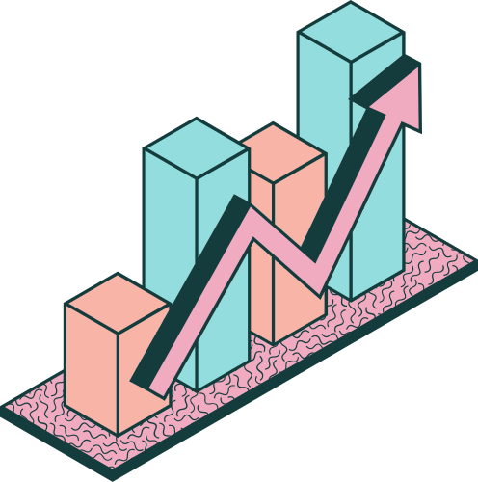
SUPERSTORE SALES
PROJECT

Slide 2
01
02
03
Project Scope
Project Steps
Data Wrangling
OVERVIEW
04
05
06
Data Analysis
Data Visualization
objectives
07
Our Team

Slide 3


01
PROJECT SCOPE
SUPERSTORE SALES
The Superstore Sales project aims to analyze sales data to identify trends, customer behaviors, and product performance. It will involve data wrangling, analysis, and visualization to provide actionable insights for optimizing inventory and improving sales strategies. The ultimate goal is to enhance overall business performance and drive growth.

Slide 4
02
PROJECT STEPS
1. DATA WRANGLING:
2. DATA ANALYSIS:
3. DATA VISUALIZATION:
This is the process of cleaning and transforming raw data into a usable format. It involves tasks such as removing inconsistencies, handling missing values, and restructuring datasets to prepare them for analysis.
This step involves examining and interpreting the cleaned data to uncover patterns, trends, and insights. Techniques can include statistical analysis or exploratory data analysis (EDA) to answer specific research questions.
This is the presentation of data in graphical or visual formats, such as charts, graphs, or dashboards. Effective visualization helps to communicate insights clearly and allows stakeholders to easily understand the findings and make informed decisions.

Slide 5
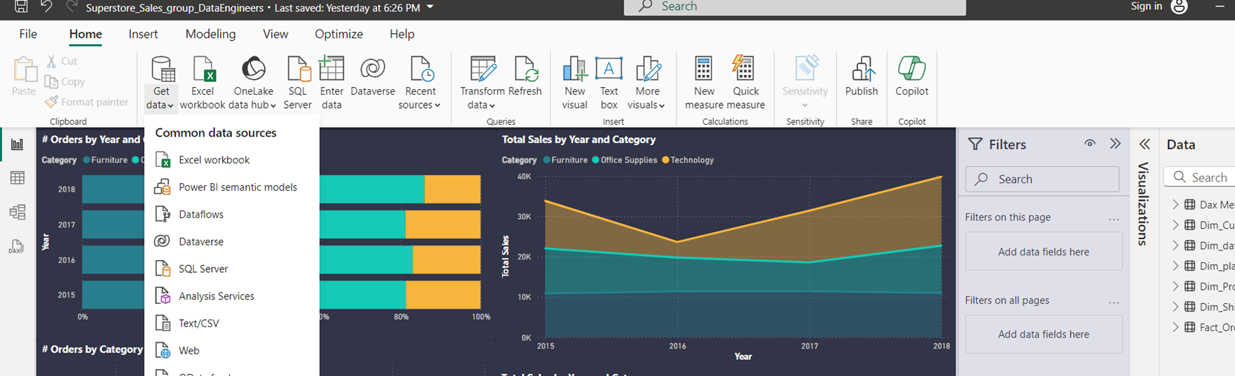
03
DATA WRANGLING:
01
Importing Data from CSV file

Slide 6
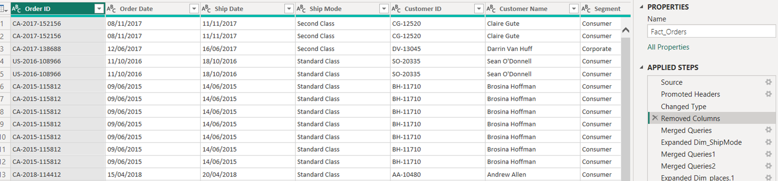
02
Data cleaning & prepration
•All columns have the correct data type except order date and ship date.
•There is ambiguity in the order date.
•Power bi converts the order and ship dates to text.

Slide 7
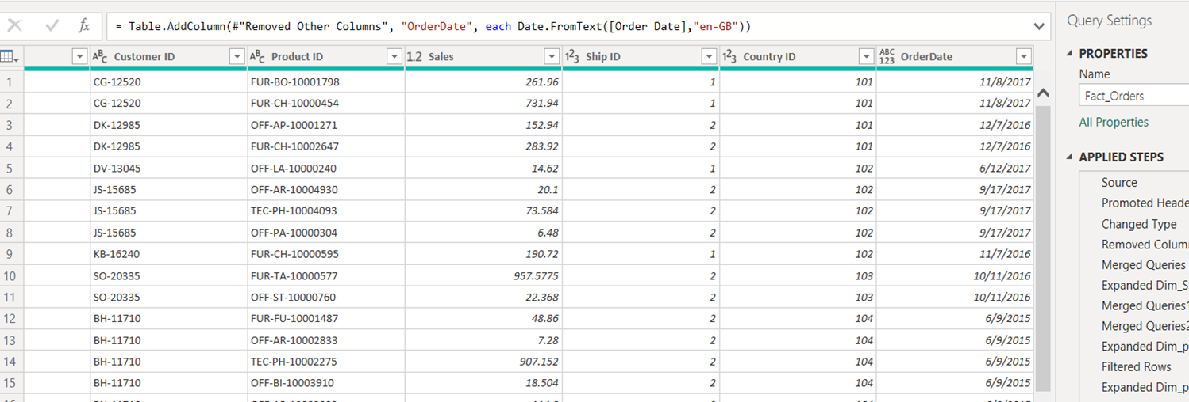
03
Correct the data type of the date
•Using M language convert date order&ship(text) to correct date format

Slide 8
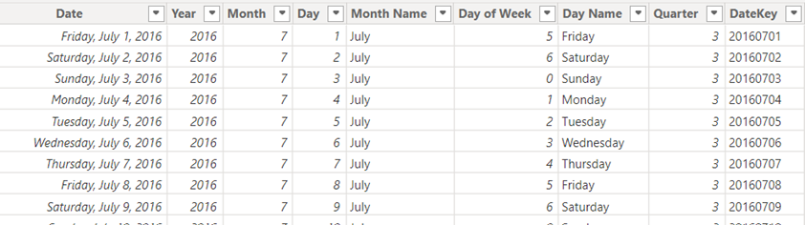
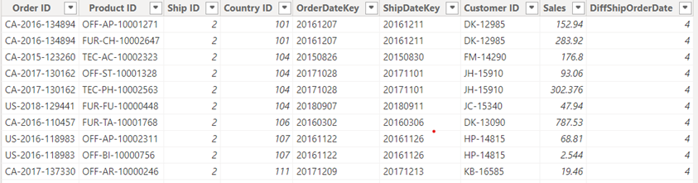
04
Data Transformation
Reshape Date
Merging queries
Custom transformations
-Reshape data
•Create star schema model
•Facts table : Measurements, metrics, or facts about an organization
•Links to dimension tables for more details
•Dimension table :Dimensions/attributes about a process
•Holds reference data Dimension tables add more detail to fact table
Fact table
Fact table

Slide 9
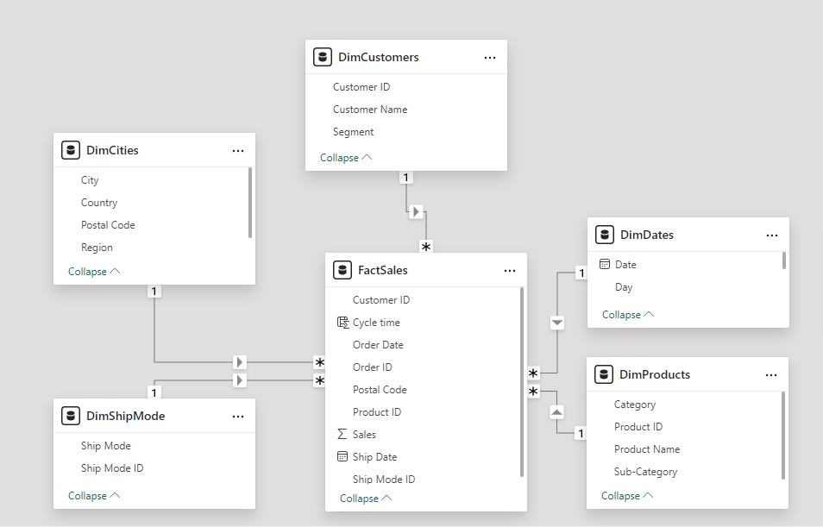
Star schema
Create Dimension tables
•Dim_Customers, Dim_places, Dim_ProductDetails, Dim_ShipMode, Dim_date
•Make primary key in each dim table and foreign keys in fact table refer to each primary key in dim tables

Slide 10
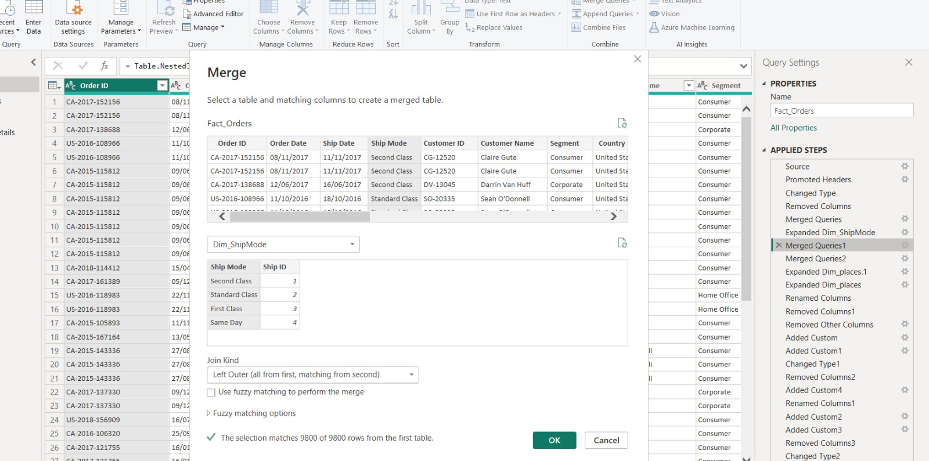
2. Merging queries
•Create merging queries between the dim table where you define the surrogate key and the fact table to create a foreign key column in it.

Slide 11
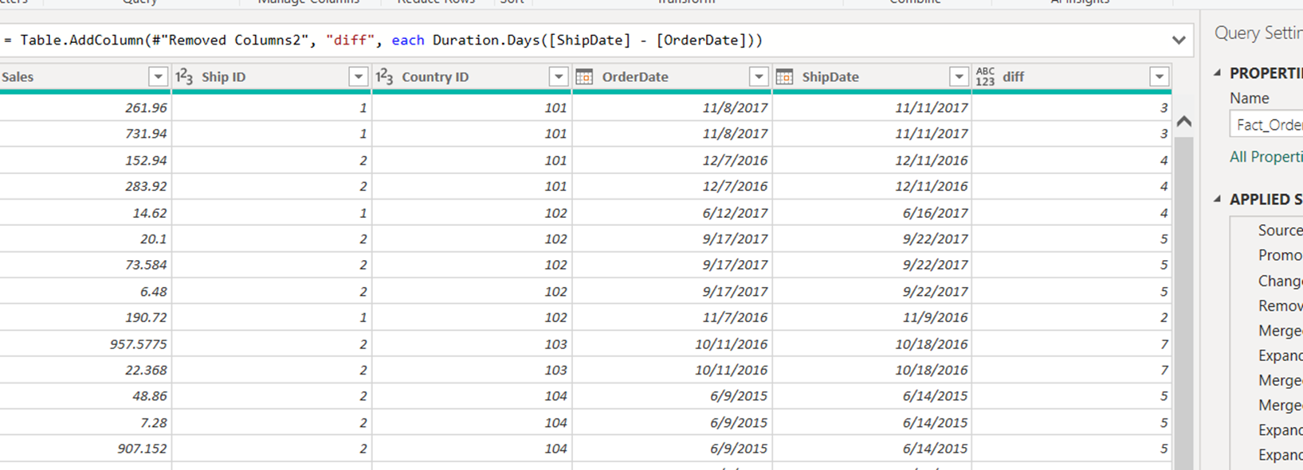
3. Custom transformations
•Create different between order date and ship date in fact table
•Using function Duration.Days([ShipDate] - [OrderDate])

Slide 12
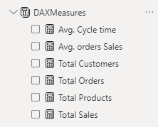
04
DATA ANALYSIS:
DAX MEASURES:
01
Total Sales = SUM(FactSales[Sales])
02
Total Orders = Count(FactSales[Order ID])
03
Total Products = COUNT(DimProducts[Product ID])
04
Total Customers = count(DimCustomers[Customer ID])
05
Avg. orders Sales = SUM(FactSales[Sales]) / COUNT(FactSales[Order ID])
06
Avg. Cycle time = SUM(FactSales[Cycle time])/COUNT(FactSales[Order ID])

Slide 13
2. POSSIBLE INSIGHTS:
CARDS
01
Total Sales
02
Total Orders
03
Total Products
04
Total Customers
05
Avg. Sales by Orders
06
Avg. Cycle time

Slide 14
2. POSSIBLE INSIGHTS:
2. SALES:
01
Sales by date. (Line chart)
02
Sales by state. (Map)
03
Sales by segments. (Donut chart or Pi chart)
04
Sales by ship mode (Donut chart or Pi chart)
05
Sales by categories , subcategories and products. ( Tree map or Decomposition tree)

Slide 15
2. POSSIBLE INSIGHTS:
3. ORDERS:
01
Orders by date. (Line chart)
02
Orders by state. (Map)
03
Orders by segments. (Donut chart, Pi chart)
04
Orders by ship mode (Donut chart or Pi chart or Decomposition tree)
05
Orders by categories , subcategories and products. ( Tree map or Decomposition tree)

Slide 16
2. POSSIBLE INSIGHTS:
4. OTHERS:
01
Average cycle time by state. (Bar chart)
02
Orders by segments and customers. (Decomposition tree)
03
Total Sales, Total Orders, Avg. Sales by Orders and Avg. Cycle Time. (Tooltip)
04
Filters by city, state, customer, segment, product, year and etc.....

Slide 17
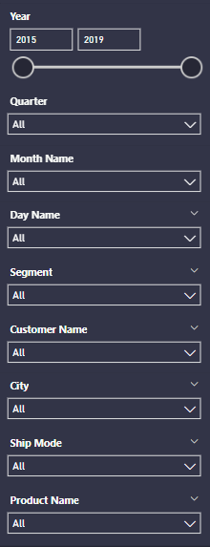
05
DATA VISUALIZATION
01
cards
02
Filters
Card visuals in Power BI are used to display single values or key metrics prominently, providing a quick and clear summary of important data points.
Filters in Power BI allow users to refine and limit the data displayed in reports and visuals based on specific criteria.

Slide 18
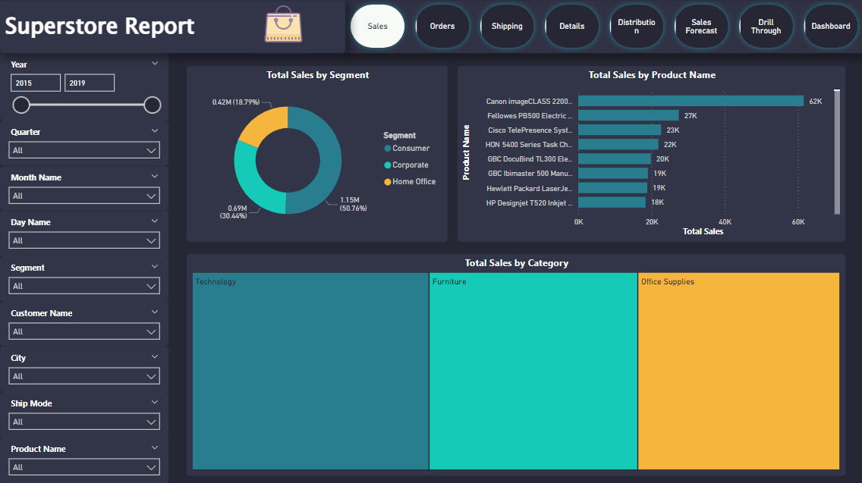
03
Sales Visuals
Consumer segment has the most sales by 51%
Canon image class 2200 Advanced Copier has the most sales 62,000$.
Technology has the most sales.

Slide 19
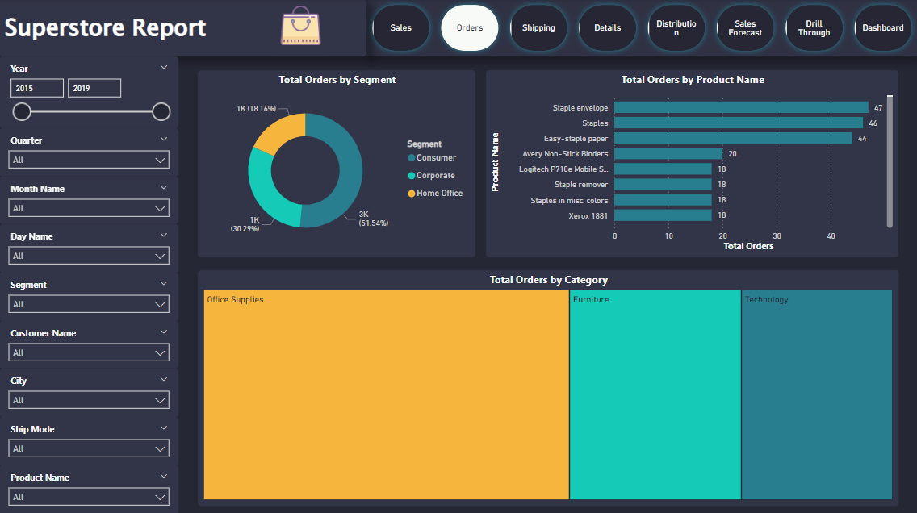
04
Orders Visuals
California has the most orders
office Supplies has Max olders & Technology has Min orders
Consumer has the most sales by 51 %.

Slide 20
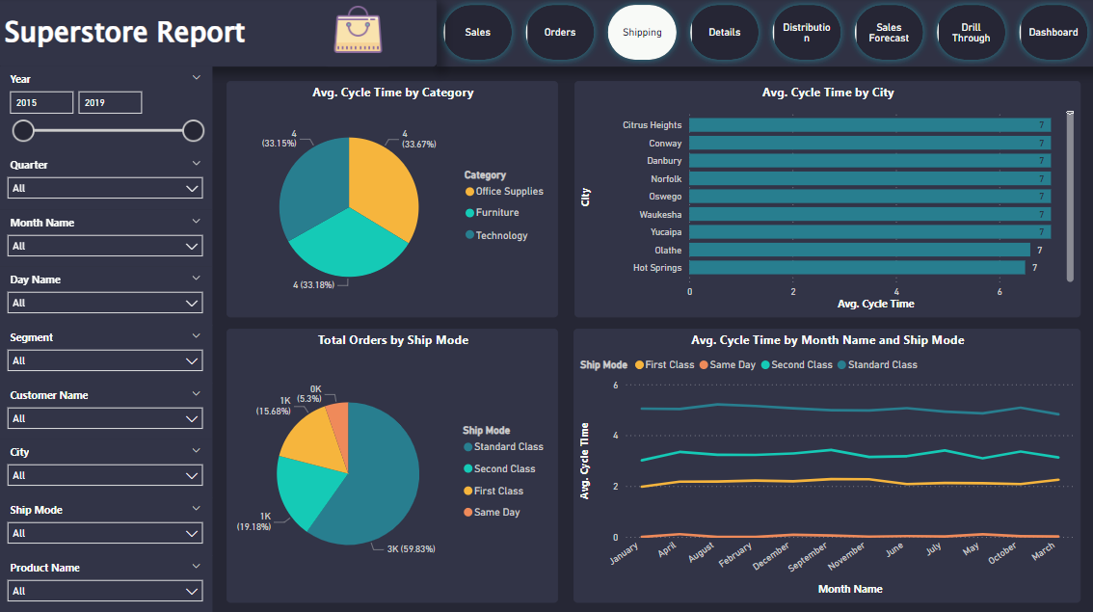
05
Details Visuals
Max C.T is 7 days at District of Columbia.
Standard Class contribute of 59.8 % of Sales.
Sales Increases at the end of the year.

Slide 21
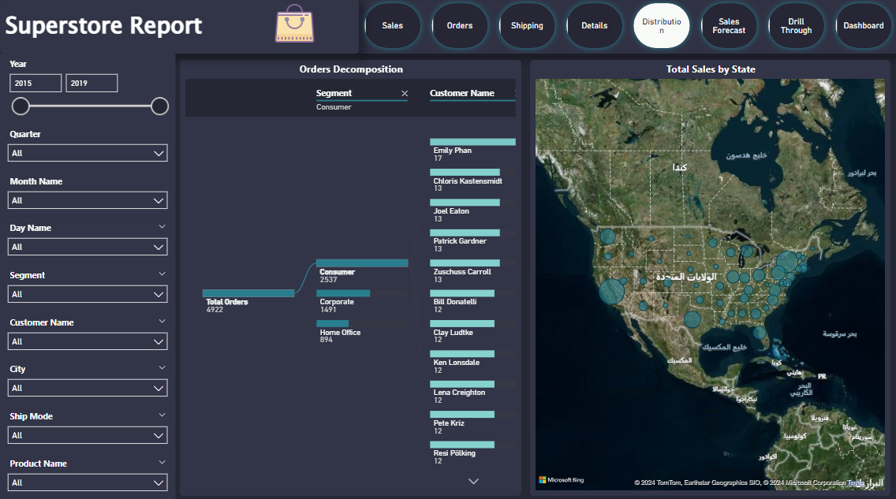
06
Map Visuals
Heat map shows sales distribution.
Customer Emily Phan has the most ouders.

Slide 22
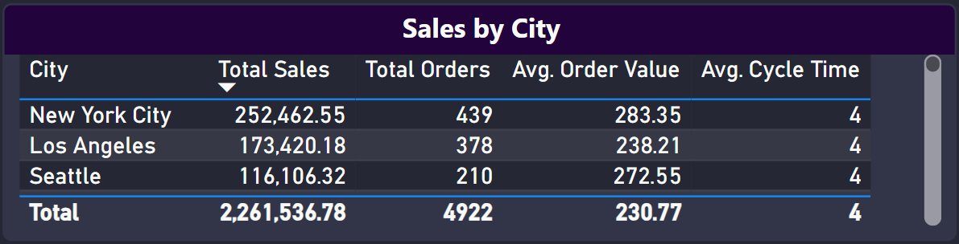
07
Tooltip
Show's These data by State (Sales, Orders, Avg. sales by order and C.T)

Slide 23
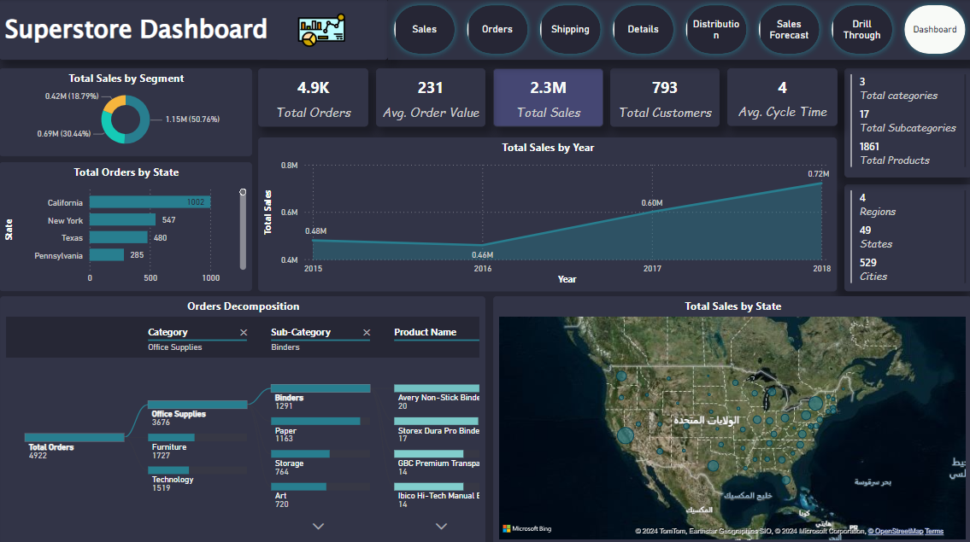
08
Dashboard
Shows Most orders by Category are office supplies.
Also shows the most important insights of these we have explained.

Slide 24

06
OBJECTIVES
Growth
refers to the increase in size, value, or importance over time, often measured in terms of revenue, market share, or user base. It can result from factors such as improved strategies, market expansion, or innovation. Sustainable growth balances short-term gains with long-term stability and profitability
Customer Satisfaction
reflects how well the shopping experience and products meet customer expectations, driving loyalty and repeat business.

Slide 25




07
OUR TEAM
MOHAMED ESSAM
MAHMOUD ERAQI
MAHMOUD ABD ELKHALEQ
Role
Role
Role
Data Wrangling
Data Analysis
Data Visualization

Slide 26

THANK YOU

